Slide 1
Lecture 06
Classification

Slide 2
Chapter 8. Classification: Basic Concepts
Classification: Basic Concepts
Decision Tree Induction
Bayes Classification Methods
Model Evaluation and Selection
Techniques to Improve Classification Accuracy: Ensemble Methods
Summary
Notes:
2

Slide 3
Decision Tree Induction: An Example
Training data set: Buys_computer
Resulting tree:
age?
<=30
overcast
>40
31..40
student?
yes
credit rating?
no
yes
excellent
fair
no
yes
no
yes

Slide 4
Algorithm for Decision Tree Induction
Basic algorithm (a greedy algorithm)
Tree is constructed in a top-down recursive divide-and-conquer manner
At start, all the training examples are at the root
Attributes are categorical (if continuous-valued, they are discretized in advance)
Examples are partitioned recursively based on selected attributes
Test attributes are selected on the basis of a heuristic or statistical measure (e.g., information gain)
Conditions for stopping partitioning
All samples for a given node belong to the same class
There are no remaining attributes for further partitioning—majority voting is employed for classifying the leaf
There are no samples left

Slide 5
Attribute Selection Measure: Information Gain (ID3/C4.5)
Select the attribute with the highest information gain
Let p_{i} be the probability that an arbitrary tuple in D belongs to class C_{i}, estimated by |C_{i, D}|/|D|
Expected information (entropy) needed to classify a tuple in D:
Information needed (after using A to split D into v partitions) to classify D:
Information gained by branching on attribute A
Notes:
I : the expected information needed to classify a given sample
E (entropy) : expected information based on the partitioning into subsets by A

Slide 6
Attribute Selection: Information Gain
Class P: buys_computer = “yes”
Class N: buys_computer = “no”
means “age <=30” has 5 out of 14 samples, with 2 yes’es and 3 no’s. Hence
Similarly,

Slide 7
Computing Information-Gain for Continuous-Valued Attributes
Let attribute A be a continuous-valued attribute
Must determine the best split point for A
Sort the value A in increasing order
Typically, the midpoint between each pair of adjacent values is considered as a possible split point
(a_{i}+a_{i+1})/2 is the midpoint between the values of a_{i} and a_{i+1}
Split:
D1 is the set of tuples in D satisfying A ≤ split-point, and D2 is the set of tuples in D satisfying A > split-point

Slide 8
Gain Ratio for Attribute Selection (C4.5)
Information gain measure is biased towards attributes with a large number of values
C4.5 (a successor of ID3) uses gain ratio to overcome the problem (normalization to information gain)
GainRatio(A) = Gain(A)/SplitInfo(A)
Ex.
gain_ratio(income) = 0.029/1.557 = 0.019
The attribute with the maximum gain ratio is selected as the splitting attribute

Slide 9
Gini Index
If a data set D contains examples from n classes, gini index, gini(D) is defined as
where p_{j} is the relative frequency of class j in D
If a data set D is split on A into two subsets D₁ and D₂, the gini index gini(D) is defined as
Reduction in Impurity:
The attribute which provides the smallest gini_{split}(D) (or the largest reduction in impurity i.e. Δgini(A)) is chosen to split the node

Slide 10
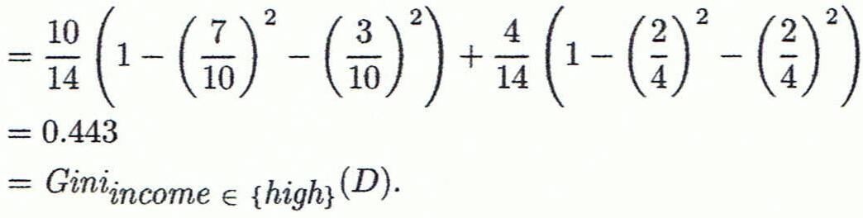
Computation of Gini Index
Ex. D has 9 tuples in buys_computer = “yes” and 5 in “no”
Suppose the attribute income partitions D into 10 in D₁: {low, medium} and 4 in D₂
Gini_{{low,high}} is 0.458; Gini_{{medium,high}} is 0.450. Thus, split on the {low,medium} (and {high}) since it has the lowest Gini index

Slide 11
Comparing Attribute Selection Measures
The three measures, in general, return good results but
Information gain:
biased towards multivalued attributes
Gain ratio:
tends to prefer unbalanced splits in which one partition is much smaller than the others
Gini index:
biased to multivalued attributes
has difficulty when # of classes is large
tends to favor tests that result in equal-sized partitions and purity in both partitions

Slide 12
Overfitting and Tree Pruning
Overfitting: An induced tree may overfit the training data
Too many branches, some may reflect anomalies due to noise or outliers
Poor accuracy for unseen samples
Two approaches to avoid overfitting
Prepruning: Halt tree construction early ̵ do not split a node if this would result in the goodness measure falling below a threshold
Difficult to choose an appropriate threshold
Postpruning: Remove branches from a “fully grown” tree—get a sequence of progressively pruned trees
Use a set of data different from the training data to decide which is the “best pruned tree”- validation data

Slide 13
Classification in Large Databases
Scalability: Classifying data sets with millions of examples and hundreds of attributes with reasonable speed
Why is decision tree induction popular?
relatively faster learning speed (than other classification methods)
convertible to simple and easy to understand classification rules
can use SQL queries for accessing databases
comparable classification accuracy with other methods

Slide 14
Chapter 8. Classification: Basic Concepts
Classification: Basic Concepts
Decision Tree Induction
Bayes Classification Methods
Model Evaluation and Selection
Techniques to Improve Classification Accuracy: Ensemble Methods
Summary
Notes:
14

Slide 15
Bayesian Classification: Why?
A statistical classifier: performs probabilistic prediction, i.e., predicts class membership probabilities
Foundation: Based on Bayes’ Theorem.
Performance: A simple Bayesian classifier, naïve Bayesian classifier, has comparable performance with decision tree and selected neural network classifiers
Incremental: Each training example can incrementally increase/decrease the probability that a hypothesis is correct

Slide 16
Bayes’ Theorem: Basics
Bayes’ Theorem:
P(H) (prior probability): the initial probability
E.g., X will buy computer, regardless of age, income, …
P(X): probability that sample data is observed
P(X|H) (likelihood): the probability of observing the sample X, given that the hypothesis holds
E.g., Given that X will buy computer, the prob. that X is 31..40, medium income

Slide 17
Prediction Based on Bayes’ Theorem
Given training data X, posteriori probability of a hypothesis H, P(H|X), follows the Bayes’ theorem
Practical difficulty: It requires initial knowledge of many probabilities, involving significant computational cost

Slide 18
Classification Is to Derive the Maximum Posteriori
Since P(X) is constant for all classes, only
needs to be maximized

Slide 19
Naïve Bayes Classifier: Training Dataset
Class:
C1:buys_computer = ‘yes’
C2:buys_computer = ‘no’
Data to be classified:
X = (age <=30, Income = medium,
Student = yes, Credit_rating = Fair)

Slide 20
Naïve Bayes Classifier: An Example
P(C_{i}): P(buys_computer = “yes”) = 9/14 = 0.643
P(buys_computer = “no”) = 5/14= 0.357
Compute P(X|C_{i}) for each class
P(age = “<=30”|buys_computer = “yes”) = 2/9 = 0.222
P(age = “<= 30”|buys_computer = “no”) = 3/5 = 0.6
P(income = “medium” | buys_computer = “yes”) = 4/9 = 0.444
P(income = “medium” | buys_computer = “no”) = 2/5 = 0.4
P(student = “yes” | buys_computer = “yes) = 6/9 = 0.667
P(student = “yes” | buys_computer = “no”) = 1/5 = 0.2
P(credit_rating = “fair” | buys_computer = “yes”) = 6/9 = 0.667
P(credit_rating = “fair” | buys_computer = “no”) = 2/5 = 0.4
X = (age <= 30 , income = medium, student = yes, credit_rating = fair)
P(X|C_{i}) : P(X|buys_computer = “yes”) = 0.222 x 0.444 x 0.667 x 0.667 = 0.044
P(X|buys_computer = “no”) = 0.6 x 0.4 x 0.2 x 0.4 = 0.019
P(X|C_{i})*P(C_{i}) : P(X|buys_computer = “yes”) * P(buys_computer = “yes”) = 0.028
P(X|buys_computer = “no”) * P(buys_computer = “no”) = 0.007
Therefore, X belongs to class (“buys_computer = yes”)

Slide 21
Naïve Bayes Classifier: Comments
Advantages
Easy to implement
Good results obtained in most of the cases
Disadvantages
Assumption: class conditional independence, therefore loss of accuracy
Practically, dependencies exist among variables
E.g., Patient’s Profile: age, family history, etc.
Symptoms: fever, cough etc., Disease: lung cancer, diabetes, etc.
Dependencies among these cannot be modeled by Naïve Bayes Classifier
How to deal with these dependencies? Bayesian Belief Networks

Slide 22
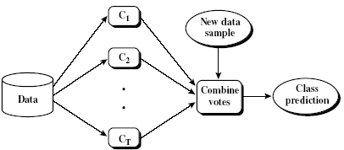
Ensemble Methods: Increasing the Accuracy
Ensemble methods
Use a combination of models to increase accuracy
Combine a series of k learned models, M₁, M₂, …, M_{k}, with the aim of creating an improved model M*
Popular ensemble methods
Bagging: averaging the prediction over a collection of classifiers
Boosting: weighted vote with a collection of classifiers
Ensemble: combining a set of heterogeneous classifiers

Slide 23
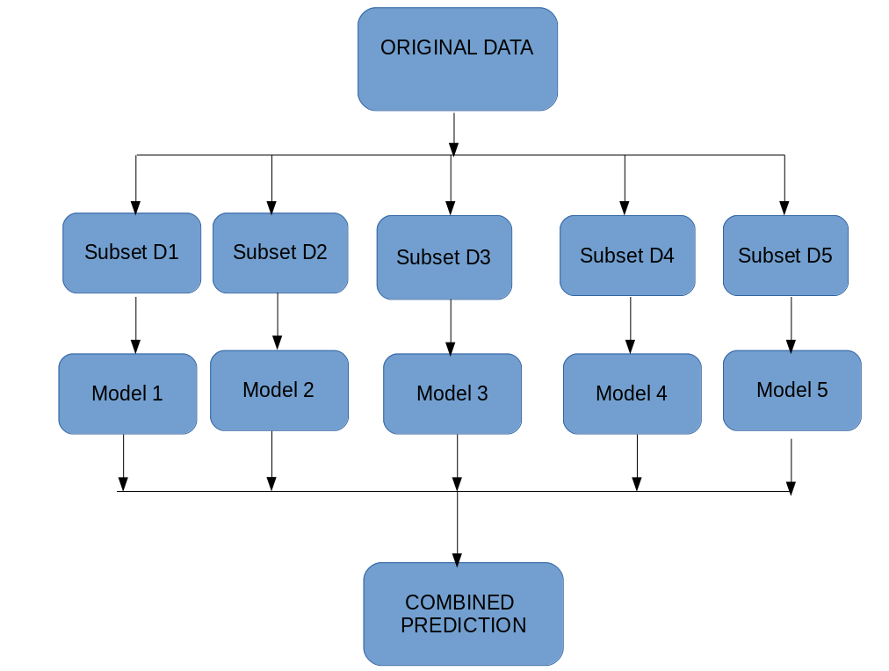
Bagging
Bagging works as follows:-
Multiple subsets are created from the original dataset, selecting observations with replacement.
A base model (weak model) is created on each of these subsets.
The models run in parallel and are independent of each other.
The final predictions are determined by combining the predictions from all the models.
Accuracy: Proven improved accuracy in prediction
Often significantly better than a single classifier derived from D
For noise data: not considerably worse, more robust

Slide 24
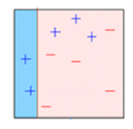
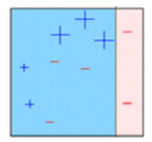
Boosting
Boosting is a sequential process, where each subsequent model attempts to correct the errors of the previous model. The succeeding models are dependent on the previous model.
When an input is misclassified by a hypothesis, its weight is increased so that next hypothesis is more likely to classify it correctly. By combining the whole set at the end converts weak learners into better performing model.

Slide 25
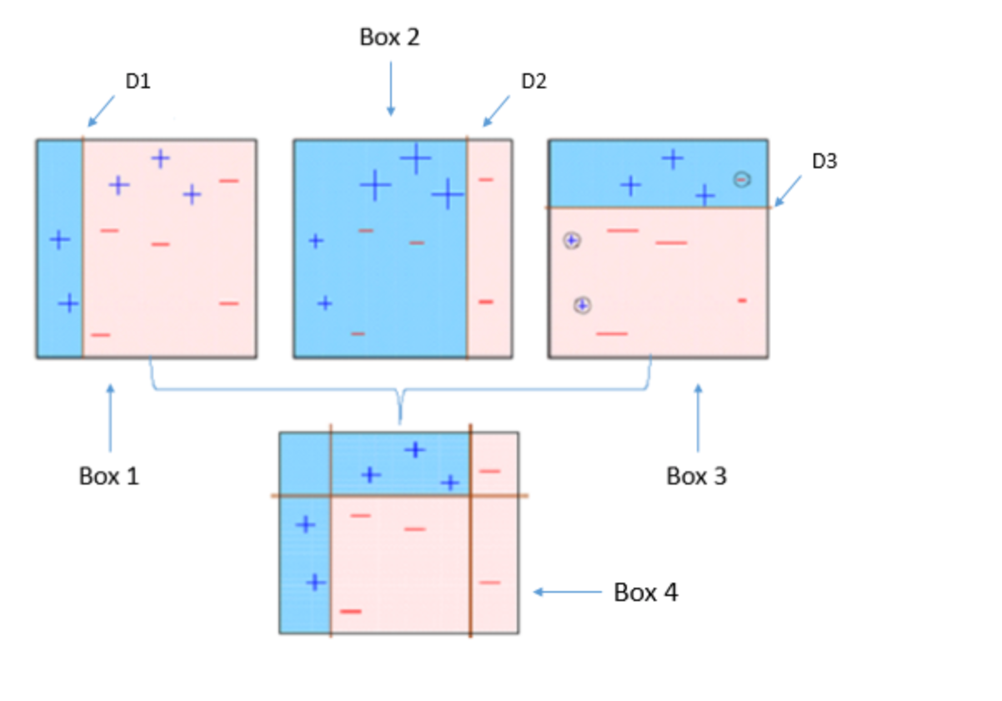
Boosting

Slide 26
Random Forest
Random Forest:
Each classifier in the ensemble is a decision tree classifier and is generated using a random selection of attributes at each node to determine the split
During classification, each tree votes and the most popular class is returned
Two Methods to construct Random Forest:
Forest-RI (random input selection): Randomly select, at each node, F attributes as candidates for the split at the node.
Forest-RC (random linear combinations): Creates new attributes (or features) that are a linear combination of the existing attributes (reduces the correlation between individual classifiers)
More robust to errors and outliers
Insensitive to the number of attributes selected for consideration at each split, and faster than bagging or boosting

Slide 27
Classification of Class-Imbalanced Data Sets
Class-imbalance problem: Rare positive example but numerous negative ones, e.g., medical diagnosis, fraud, oil-spill, fault, etc.
Traditional methods assume a balanced distribution of classes and equal error costs: not suitable for class-imbalanced data
x
x
x
Typical methods in two-class classification:
Oversampling: re-sampling of data from positive class
Under-sampling: randomly eliminate tuples from negative class
Threshold-moving: move the decision threshold, t, so that the rare class tuples are easier to classify, and hence, less chance of costly false negative errors
Ensemble techniques: Ensemble multiple classifiers introduced above
Still difficult for class imbalance problem on multiclass tasks
x
x
x
x
x
x
x
x
x
x
x
x
x
x
o
x
x
x
o
o
x
x
x
x
x
o
x
x

